Slide 1
Ngāti tukorehe
RESPONDS
Grenadier Limited
Douglas Links golf course proposal
4 may 2022

Slide 2

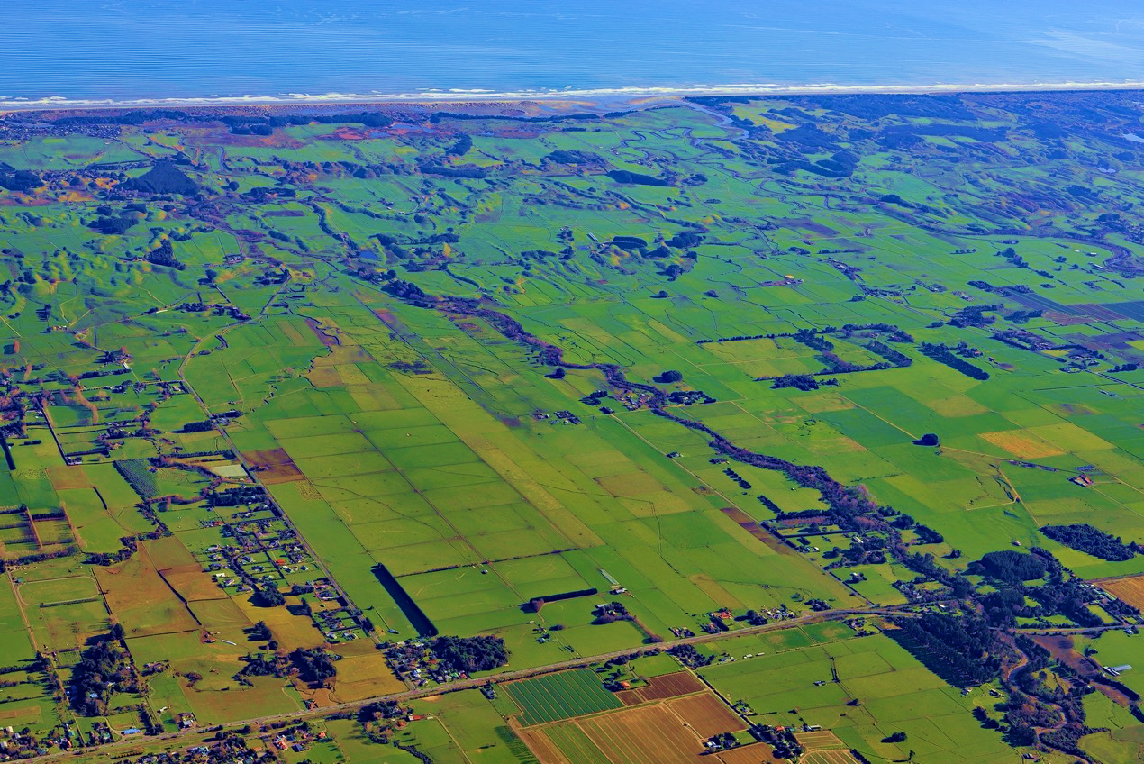
WAHANGA TUATAHI:
WHAKAPAPA (Existence & interconnectedness)

Slide 3
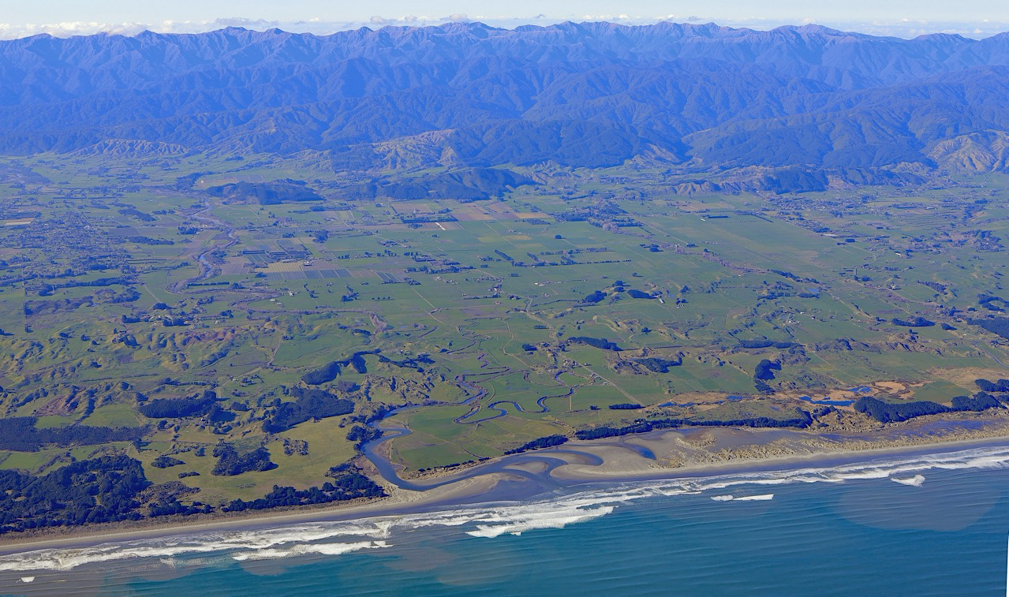
Notes:
TECHNICAL REPORT
For adaptations strategies
Ecological economics for wetlands Phase 2 Risk Management Planning for Climate Change Impacts on Māori coastal ecosystems and economies.
and for Harakeke,

Slide 4
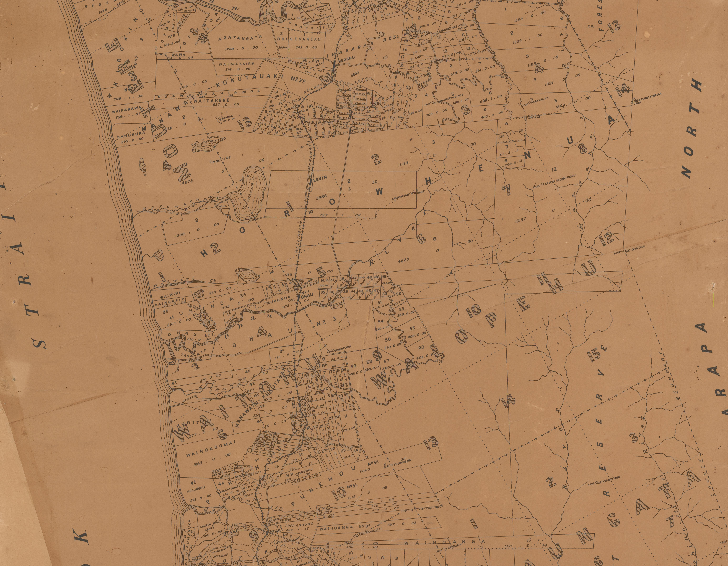



Slide 6
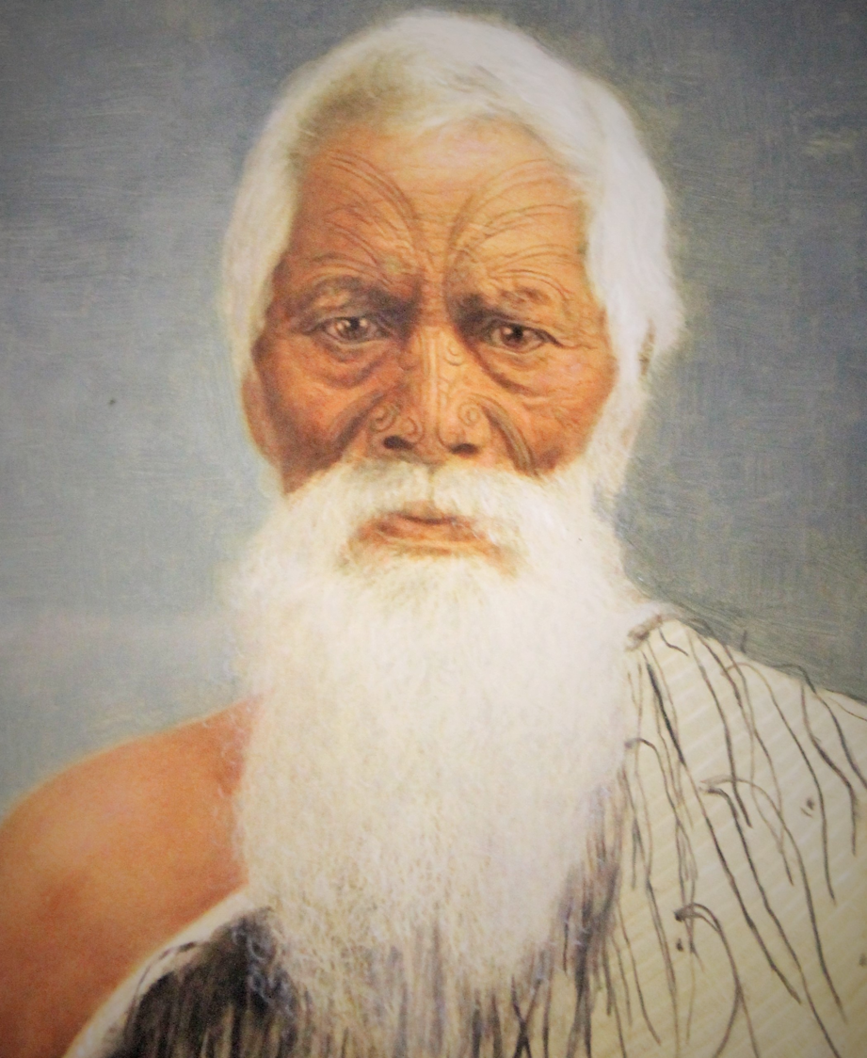
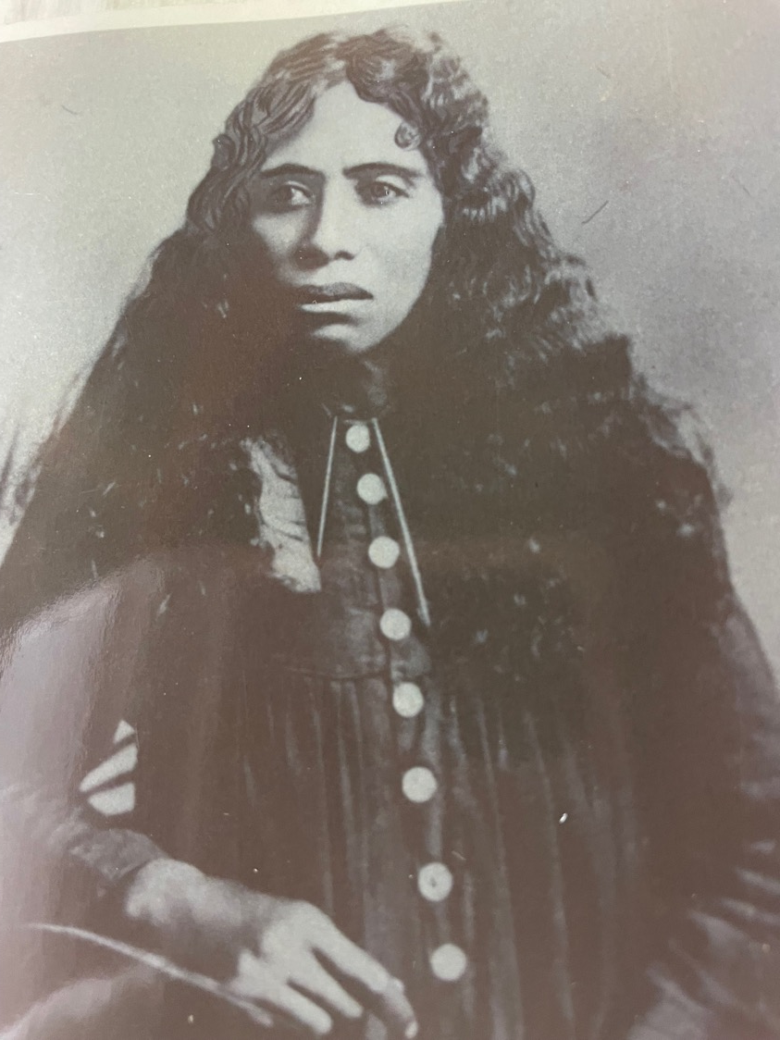

Slide 7
WAHANGA TUARUA:
TAIAO (Environment & interconnectedness)

Slide 8
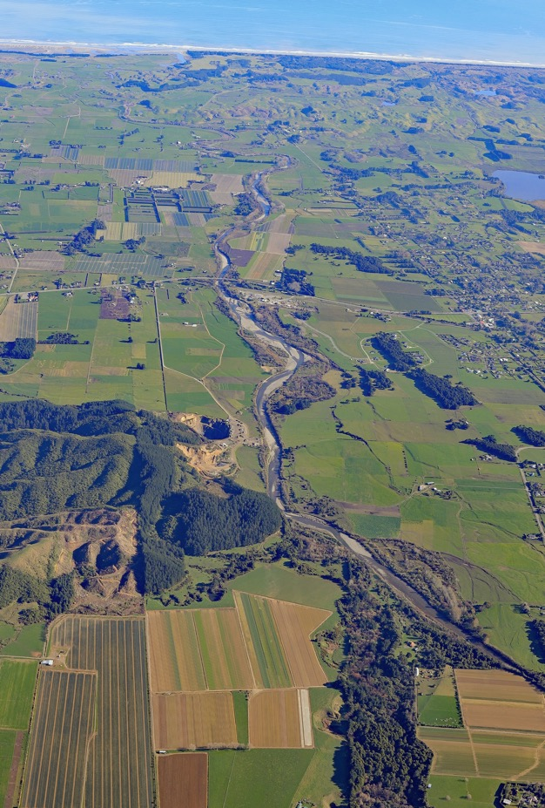

Pukeatua to Tirotiro-whetu

Slide 9

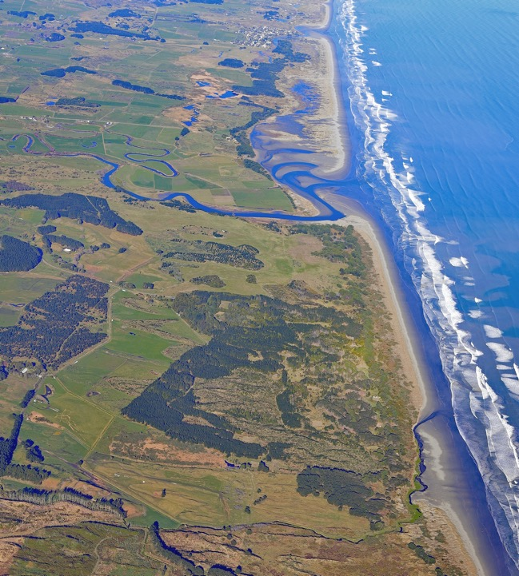
Waiwiri Stream to Waikawa
Former papa kāinga and mahinga mataitai
Muhunoa, Kāingapipi, Ōhine lagoon
Tirotirowhetu, Te Rauawa and Tahamata

Slide 10
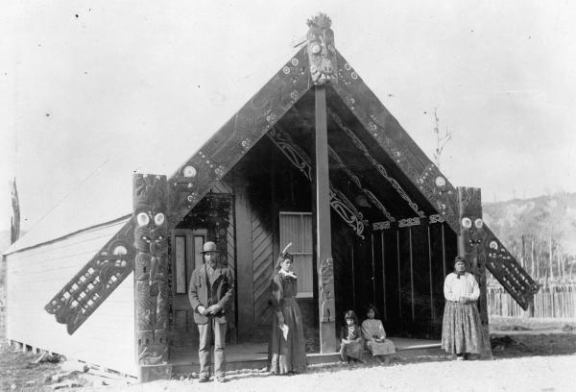

Slide 11
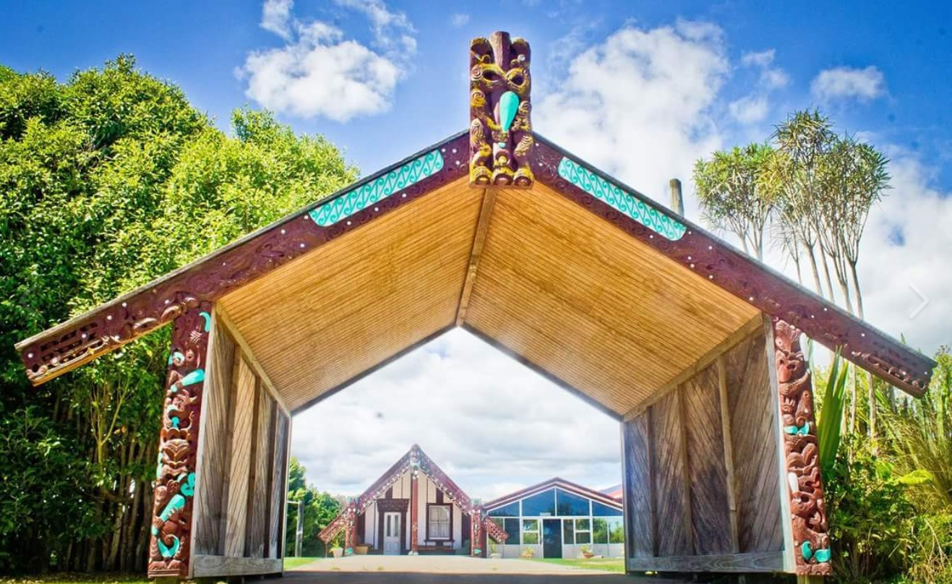

Slide 12
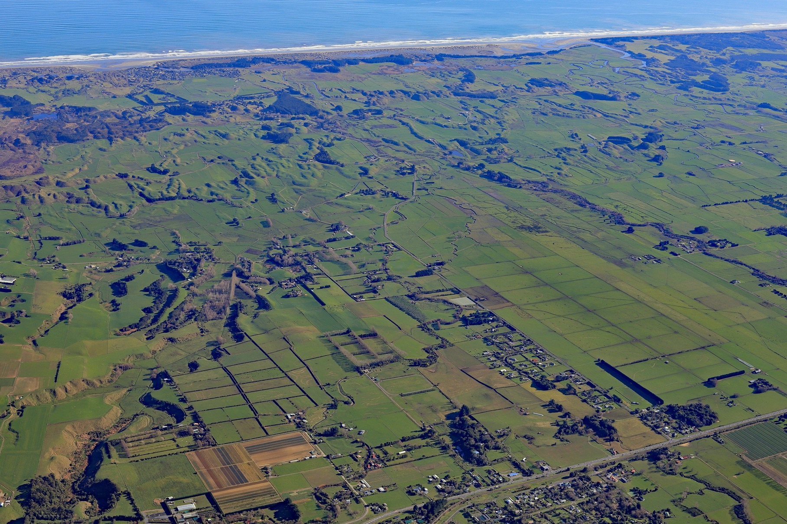

Slide 13
MANA – PRESTIGE, AUTHORITY,
EMPOWERMENT AND LEADERSHIP
MANA TAONGA – ACKNOWLEDGING and VALUING the CONNECTIONS BETWEEN EVERYTHING
MANA WHENUA /Ahi Kaa – KEEPING THE HOME FIRES ALIVE
MANA TANGATA – THE INFLUENCE OF COLLECTIVE WORTH
MANA ATUA – ACKNOWLEDGING SPIRITUAL DIMENSIONS
WHAKAPAPA
TINO RANGATIRATANGA
MANA
ACTIVE KAITIAKITANGA
Notes:
MANA Empowerment and leadership
Tino rangatiratanga – The road to self-determination 00
Whakapapa – Identity and interconnectedness 00
Mana – Empowerment and leadership 00
Kaitiakitanga – Protection and sustainability

Slide 14
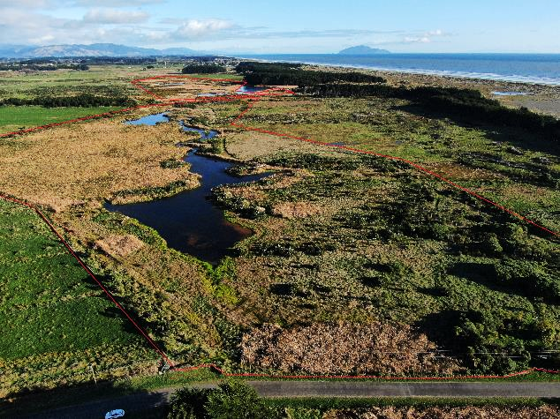
Te Hākari/
Te Hākiri Dune
Wetland –
Reforestation and
raising of water
levels
since Sept 2022
Return of mātātā (fern bird)
sighted and heard since June
2021

Slide 15
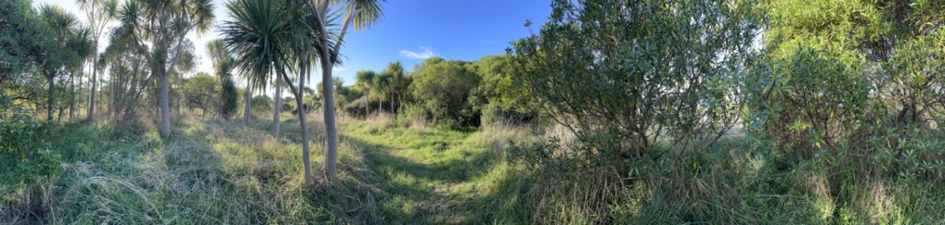
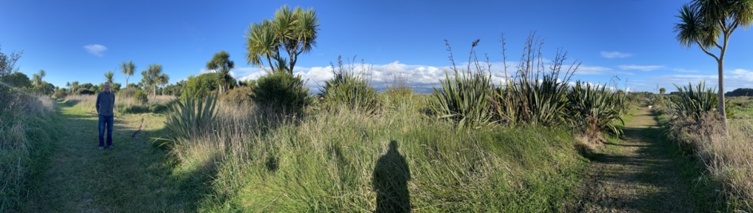

Slide 16
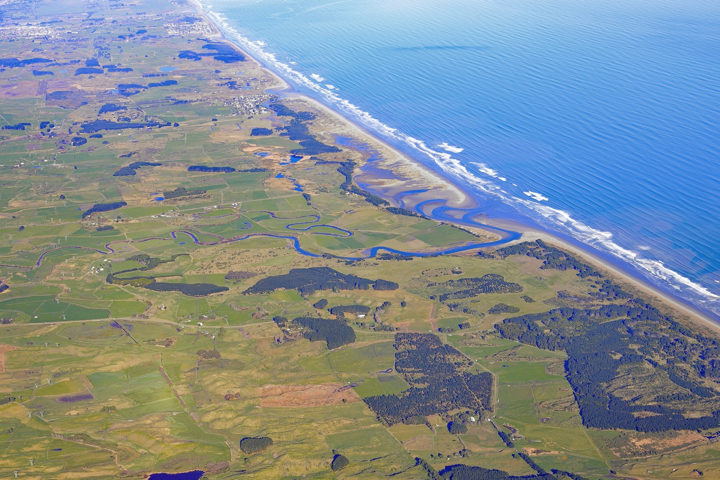

Slide 17

Manaaki Taha Moana: enhancing coastal ecosystems for iwi and hapū (2010-2015)
https://www.mtm.ac.nz/publications
MBIE funded PHASE 1: Adaptation Strategies to Address Climate Change Impacts on Coastal Māori Communities (2015-2017)
MBIE funded PHASE 2: Risk Management Planning for Climate Change Impacts on Māori Coastal Ecosystems and Economies project (2017-2019)
MBIE funded PHASE 3: Manaaki i ngā taonga i tukua mai e ngā tupuna: investigating action-oriented climate change transitions to water-based land uses that enhance taonga species (2020-2022)
https://deepsouthchallenge.co.nz/our-research/
Notes:
Kaupapa Māori | Action-Orientated Research | Active Kaitiakitanga
Transformative Collaboration with multiple entities
Mātauranga Māori with Western Science but respectful coming together upon Māori lands
Solutions Focused

Slide 18
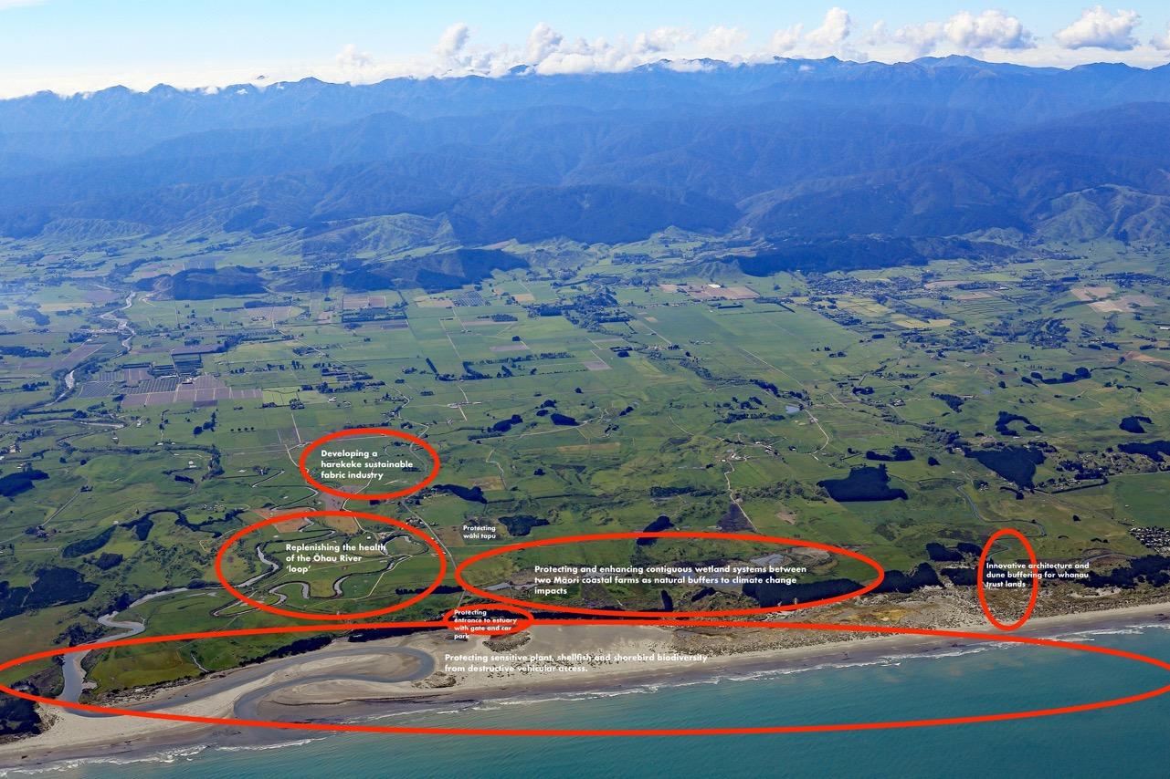
Notes:
Kaupapa Māori | Action-Orientated Research | Active Kaitiakitanga
Transformative Collaboration with multiple entities
Mātauranga Māori with Western Science but respectful coming together upon Māori lands
Solutions Focused

Slide 19
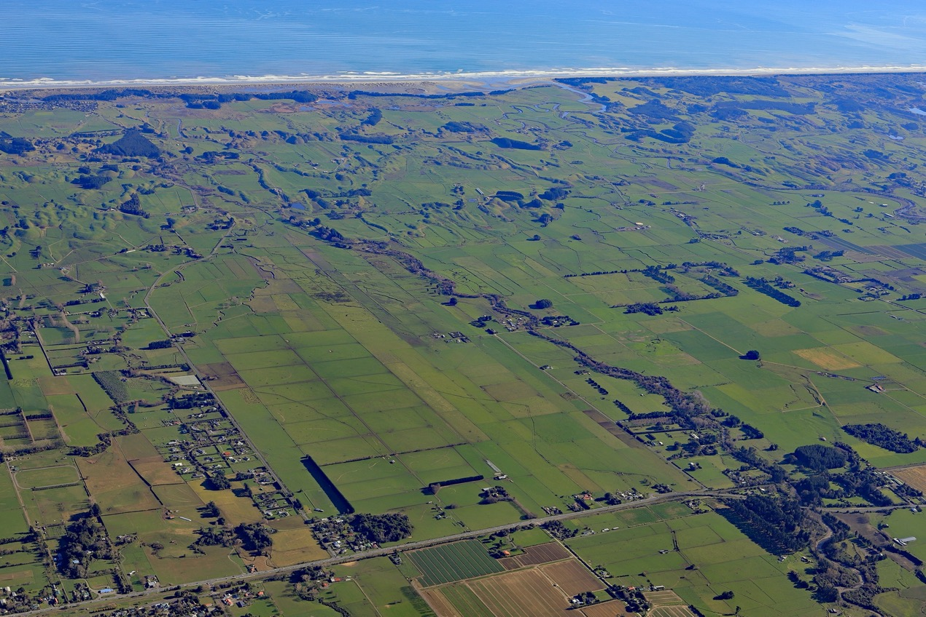

Slide 20
WAHANGA TUATORU:
NGĀ OHAOHA (Economic & interconnectedness)

Slide 21
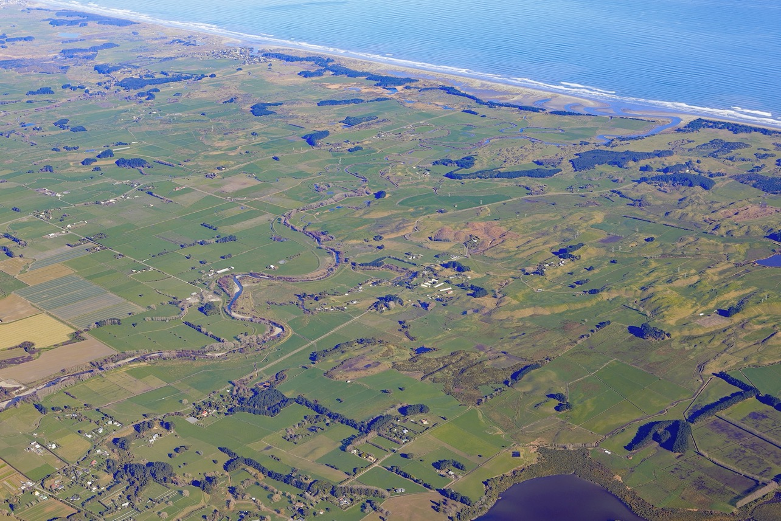

Slide 22
TAHAMATA
Tahamata Incorporation formed in 1974 to protect Māori land from sale to non-Māori
Governed by a Committee of Management under Te Turi Whenua Act 1993
36,950 shares – all shareholders whakapapa to Ngāti Tukorehe
Dairy Farming; Beef finishing; Forestry; Wetland
Mātātā (Fernbird) has re-established in Te Hākari /Te Hakiri Wetland.

Slide 23
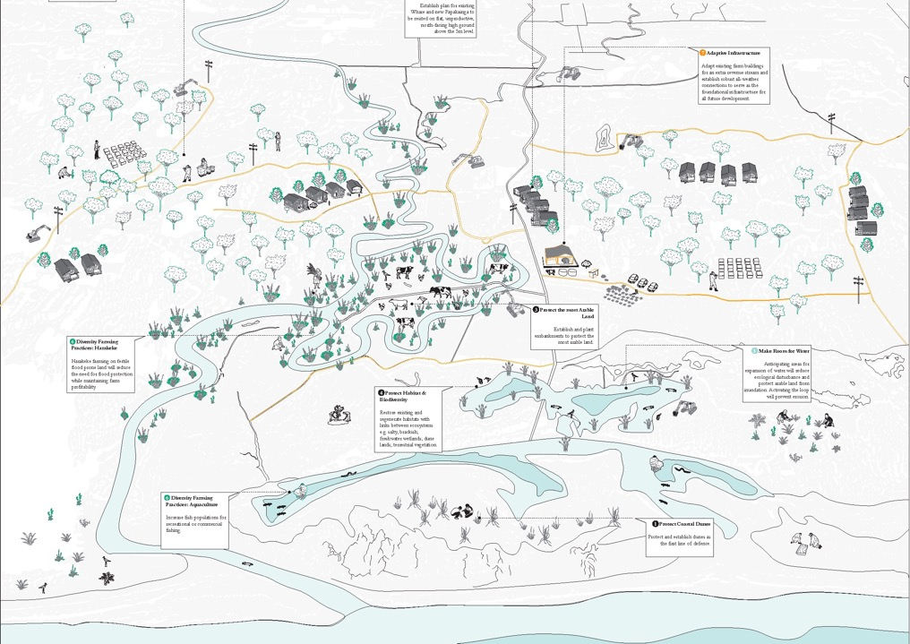
Sustainable farming

Slide 24
KAITIAKITANGA
Traditional area settled by our tupuna – from the Mountains to the Sea
History is alive through story telling of pre and post European Times
Kaitiakitanga is at the core of Tahamata Incorporation’s Strategic Planning
Examples include: protecting whānau land from dispersal; planting of waterways, retiring of land into Wetlands; support of traditional harvesting of kaimoana; hosting research projects into climate change, and encouragement of biodiversity to flourish.

Slide 25
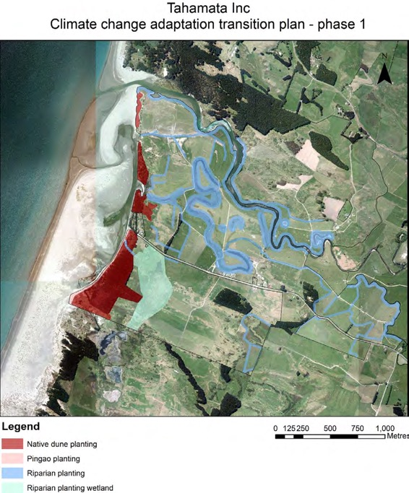
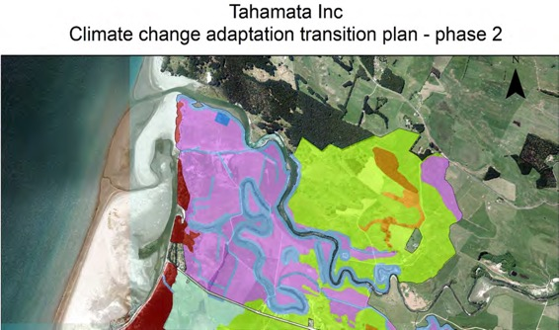
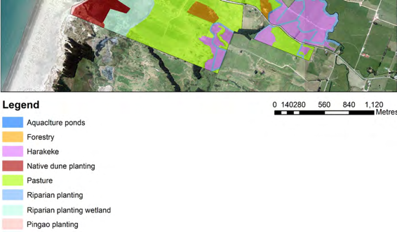

Slide 26
TAHAMATA AND DOUGLAS LINKS – MEETING
Investigative meeting arranged by the then Tahamata Chair, Troy Hobson
Seeking information as to the development of utilities to service the proposed Golf Links - Tahamata’s sub-division plans along Muhunoa West Road were held up by the lack of telephone/power.
Purpose of meeting was to inform Tahamata’s internal investigation
Douglas Links was informed at that meeting to contact Ngāti Tukorehe at the Marae for Iwi consultation.

Slide 27
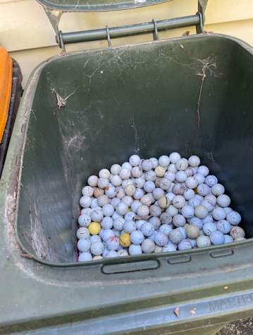
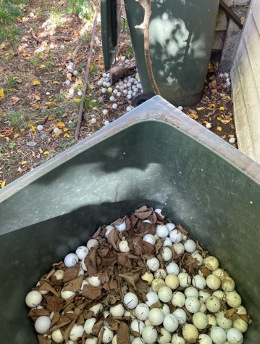
Golf balls and golf balls….
GOLF BALLS
20,000 golf balls collected and stored
In a natural and/or farming environment they are rubbish – don’t break down
Mitigation actions largely ineffective – balls become buried in sand or submerged.
Biodegradable balls?

Slide 28

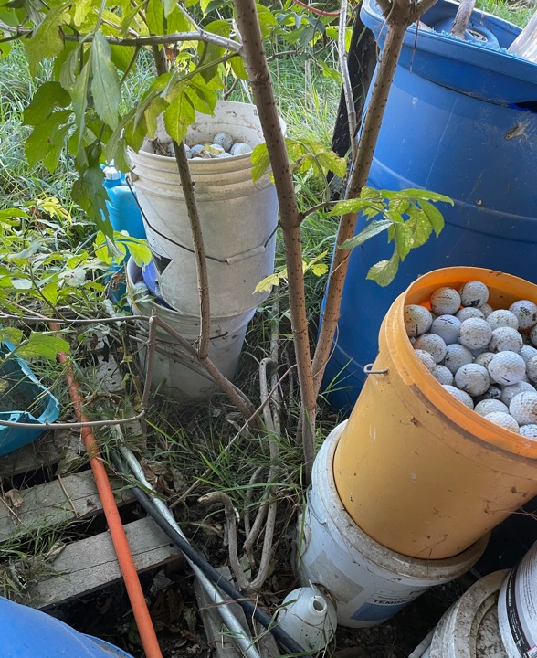
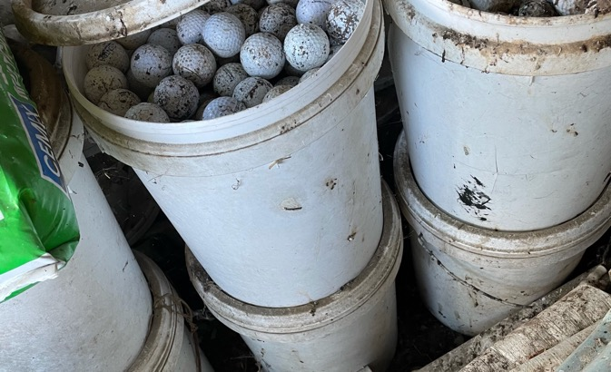
…and more golf balls

Slide 29
WAHANGA TUAWHĀ:
NGĀ OHAOHA & WHAKAKĀPI (Economic & interconnectedness)

Slide 30



YOUNG POPULATION
Huge importance of relationships –
time and resources to build and maintain
Kaitiakitanga (guardianship) and quadruple bottom lines – cultural, environmental, social as well as commercial drivers
Values-driven businesses, often with broad and varied community obligations
Economic Drivers
Taiao
Taonga Tuku-iho
People
Entities
Leadership
Impact, Outcomes, Priorities
Relationships
Properity
Mana
Hauora
He kai kei āku ringa
70%
Māori are under 40 yrs
ASSETS
Tukorehe
Intergenerational approach to investment and resource use –
225 year strategic
plan
Different land tenure and asset-ownership structures and regulations
$70b
Māori asset base
LAND TRUSTS & INCs
Willingness to collaborate, both formally and informally, as well as tuakana-teina* relationships to support others
Many based in regional and provincial areas, particularly Iwi, and Māori Trusts and Incorporations
12,000 +
Māori land trusts & incorporations
Complex governance structures and reporting obligations

Slide 31


